Slide 1
Object-Oriented Software Engineering
Practical Software Development using UML and Java
Chapter 5:
Modelling with Classes

Slide 2
5.1 What is UML?
The Unified Modelling Language is a standard graphical language for modelling object oriented software
  Developed by Rumbaugh, Booch and Jacobson
  Based on earlier languages they had each developed
  They worked together at the Rational Software Corporation, later bought by IBM
    Much development of UML has been done at IBM Rational Ottawa
  In 1997 the Object Management Group (OMG) started the process of UML standardization
© Lethbridge/Laganière 2012
Chapter 5: Modelling with classes

Slide 3
UML diagrams
  Class diagrams
    describe classes and their relationships
  Interaction diagrams
    Sequence and communication diagrams
    Show the behaviour of systems in terms of how objects interact with each other
  State diagrams and activity diagrams
    show how systems or classes behave internally
  Component and deployment diagrams
    show how the various components of systems are arranged logically and physically
© Lethbridge/Laganière 2012
Chapter 5: Modelling with classes

Slide 4
5.2 Essentials of UML Class Diagrams
The main symbols shown on class diagrams are:
  Classes
      represent the types of data themselves
  Associations
      represent linkages between instances of classes
  Attributes
      are simple data found in classes and their instances
  Operations
      represent the abstract functions performed by the classes and their instances, as well as specific methods implementing these
  Generalizations
      group classes into inheritance hierarchies
© Lethbridge/Laganière 2012
Chapter 5: Modelling with classes

Slide 5
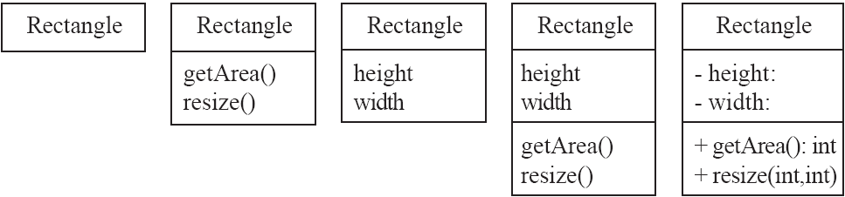
Classes
A class is simply represented as a box with the name of the class inside
  The diagram may also show the attributes and operations
  The complete signature of an operation is:
    operationName(parameterName: parameterType …): returnType
© Lethbridge/Laganière 2012
Chapter 5: Modelling with classes

Slide 6
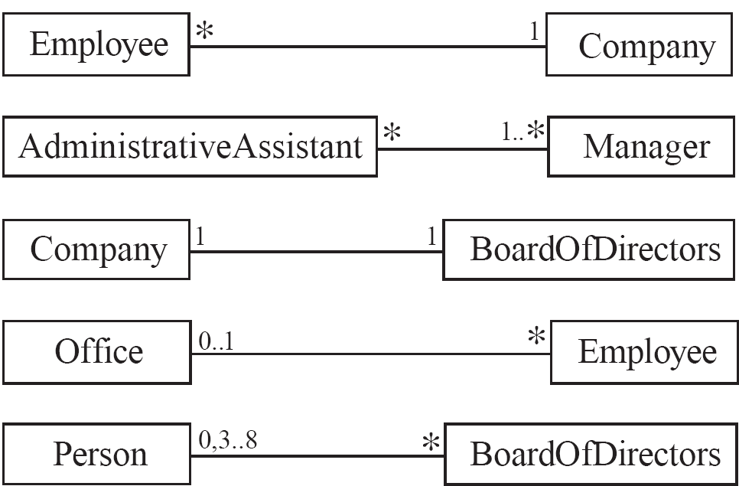
5.3 Associations and Multiplicity
An association is used to show how two classes are related to each other
  Symbols indicating multiplicity are shown at each end of the association
© Lethbridge/Laganière 2012
Chapter 5: Modelling with classes

Slide 7
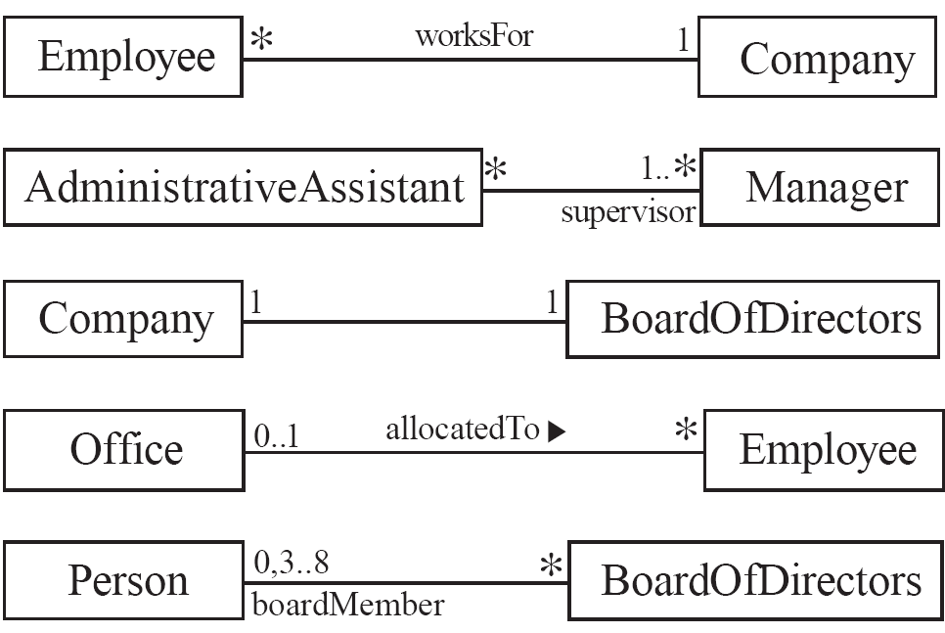
Labelling associations
  Each association can be labelled, to make explicit the nature of the association
© Lethbridge/Laganière 2012
Chapter 5: Modelling with classes

Slide 8
Analyzing and validating associations
  Many-to-one
    A company has many employees,
    An employee can only work for one company.
      This company will not store data about the moonlighting activities of employees!
    A company can have zero employees
      E.g. a ‘shell’ company
    It is not possible to be an employee unless you work for a company
Employee
*
worksFor
1
Company
© Lethbridge/Laganière 2012
Chapter 5: Modelling with classes

Slide 9
Analyzing and validating associations
  Many-to-many
    An assistant can work for many managers
    A manager can have many assistants
    Assistants can work in pools
    Managers can have a group of assistants
    Some managers might have zero assistants.
    Is it possible for an assistant to have, perhaps temporarily, zero managers?
*
1..*
*
*
*
*
Assistant
*
Manager
supervisor
Open in Umple
© Lethbridge/Laganière 2012
Chapter 5: Modelling with classes

Slide 10
Analyzing and validating associations
  One-to-one
    For each company, there is exactly one board of directors
    A board is the board of only one company
    A company must always have a board
    A board must always be of some company
1
1
Open in Umple
© Lethbridge/Laganière 2012
Chapter 5: Modelling with classes

Slide 11
Top Hat Monocle Questions
Building – Classroom
Elevator
© Lethbridge/Laganière 2012
Chapter 5: Modelling with classes

Slide 12
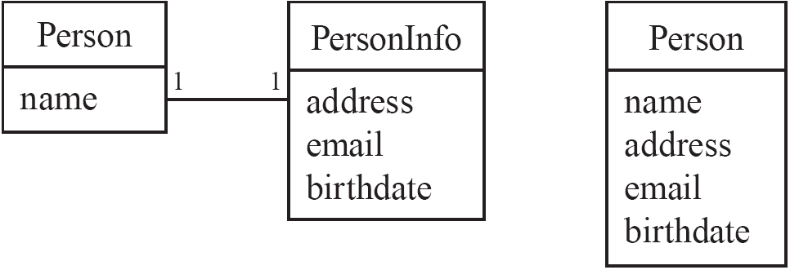
Analyzing and validating associations
Avoid unnecessary one-to-one associations
Avoid this do this
© Lethbridge/Laganière 2012
Chapter 5: Modelling with classes

Slide 13
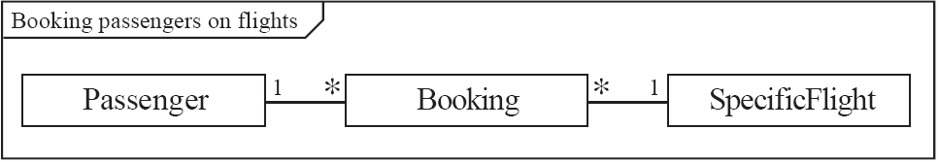
A more complex example
  A booking is always for exactly one passenger
    no booking with zero passengers
    a booking could never involve more than one passenger.
  A Passenger can have any number of Bookings
    a passenger could have no bookings at all
    a passenger could have more than one booking
  The frame around this diagram is an optional feature that any UML 2.0 may possess.
© Lethbridge/Laganière 2012
Chapter 5: Modelling with classes

Slide 14
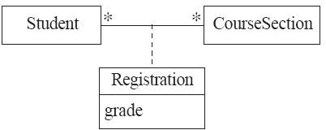

Association classes
  Sometimes, an attribute that concerns two associated classes cannot be placed in either of the classes
  The following are equivalent
Open in Umple and extended example
© Lethbridge/Laganière 2012
Chapter 5: Modelling with classes

Slide 15
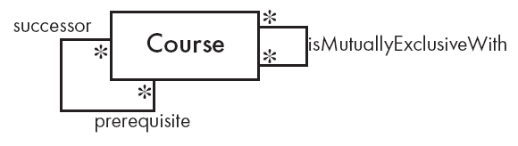
Reflexive associations
  It is possible for an association to connect a class to itself
Open in Umple
© Lethbridge/Laganière 2012
Chapter 5: Modelling with classes

Slide 16
Top Hat Monocle Question
Symmetric Reflexive Associations
© Lethbridge/Laganière 2012
Chapter 5: Modelling with classes

Slide 17

Directionality in associations
Associations are by default bi-directional
It is possible to limit the direction of an association by adding an arrow at one end
Open in Umple
© Lethbridge/Laganière 2012
Chapter 5: Modelling with classes

Slide 18
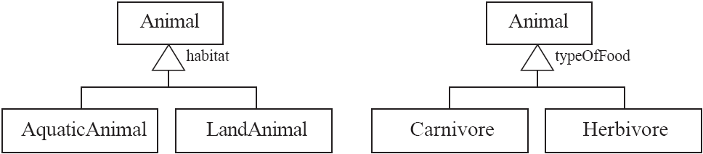
5.4 Generalization
Specializing a superclass into two or more subclasses
  A generalization set is a labeled group of generalizations with a common superclass
  The label (sometimes called the discriminator) describes the criteria used in the specialization
© Lethbridge/Laganière 2012
Chapter 5: Modelling with classes

Slide 19
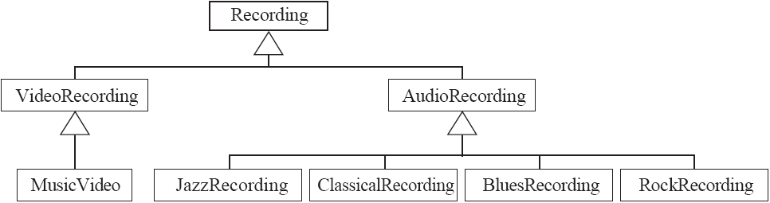
Avoiding unnecessary generalizations
Inappropriate hierarchy of
classes, which should be
instances
© Lethbridge/Laganière 2012
Chapter 5: Modelling with classes

Slide 20
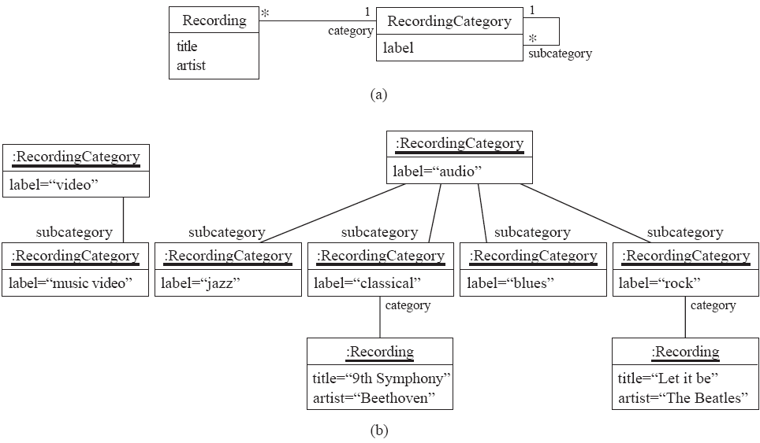
Avoiding unnecessary generalizations (cont)
Open in Umple
Improved class diagram, with its corresponding instance diagram
© Lethbridge/Laganière 2012
Chapter 5: Modelling with classes

Slide 21
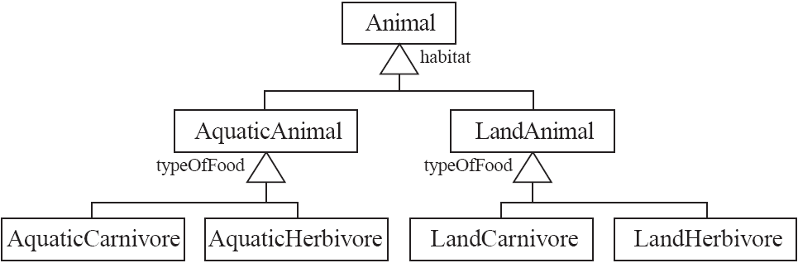
Handling multiple discriminators
  Creating higher-level generalization
© Lethbridge/Laganière 2012
Chapter 5: Modelling with classes

Slide 22
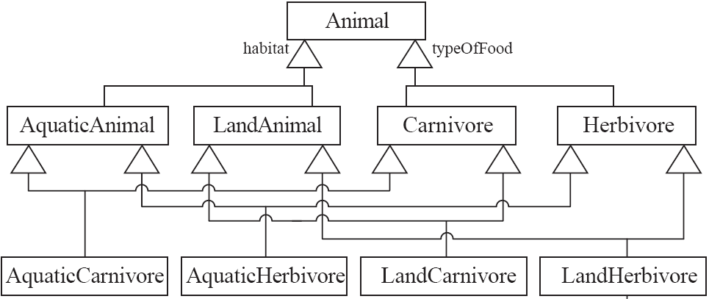
Handling multiple discriminators
  Using multiple inheritance
  Using the Player-Role pattern (in Chapter 6)
© Lethbridge/Laganière 2012
Chapter 5: Modelling with classes

Slide 23
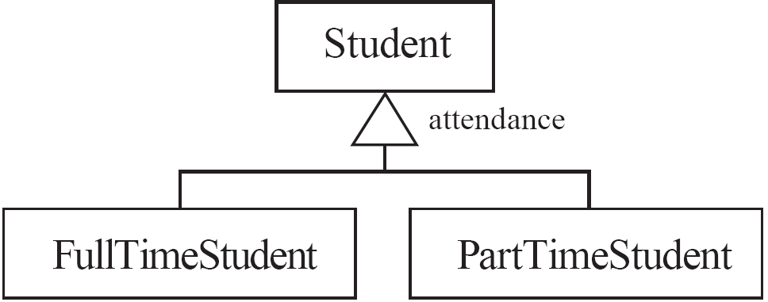
Avoiding having instances change class
  An instance should never need to change class
© Lethbridge/Laganière 2012
Chapter 5: Modelling with classes

Slide 24
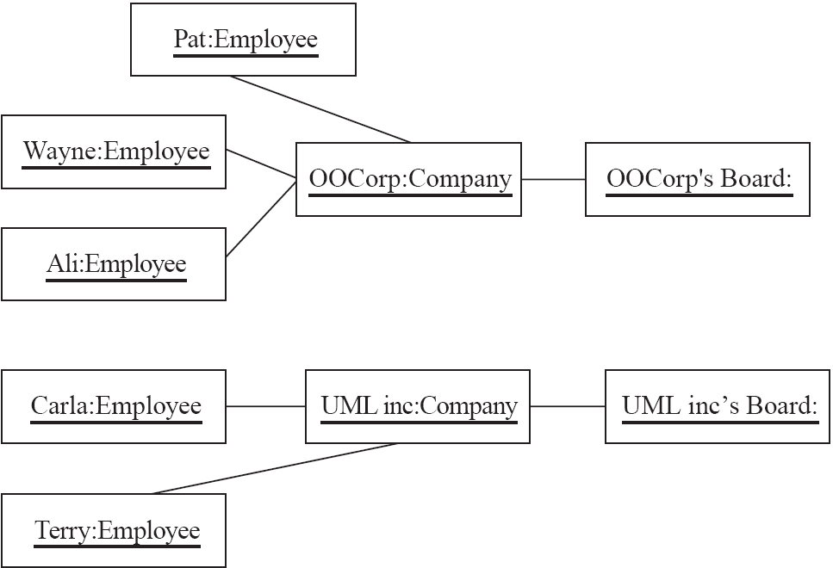
5.5 Object Diagrams
  A link is an instance of an association
    In the same way that we say an object is an instance of a class
© Lethbridge/Laganière 2012
Chapter 5: Modelling with classes

Slide 25
Associations versus generalizations in object diagrams
  Associations describe the relationships that will exist between instances at run time.
    When you show an instance diagram generated from a class diagram, there will be an instance of both classes joined by an association
  Generalizations describe relationships between classes in class diagrams.
    They do not appear in instance diagrams at all.
    An instance of any class should also be considered to be an instance of each of that class’s superclasses
© Lethbridge/Laganière 2012
Chapter 5: Modelling with classes

Slide 26
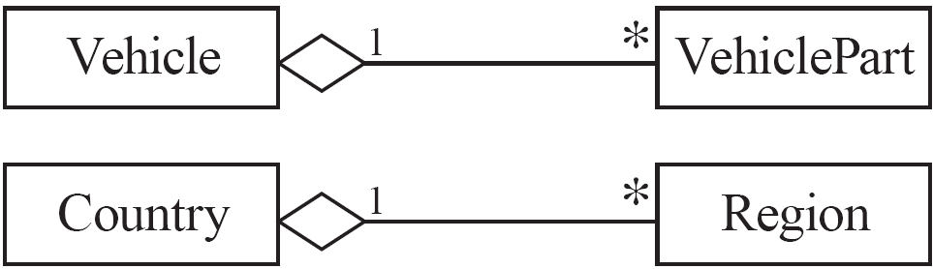
5.6 More Advanced Features: Aggregation
  Aggregations are special associations that represent ‘part-whole’ relationships.
    The ‘whole’ side is often called the assembly or the aggregate
    This symbol is a shorthand notation association named isPartOf
© Lethbridge/Laganière 2012
Chapter 5: Modelling with classes

Slide 27
When to use an aggregation
As a general rule, you can mark an association as an aggregation if the following are true:
  You can state that
    the parts ‘are part of’ the aggregate
    or the aggregate ‘is composed of’ the parts
  When something owns or controls the aggregate, then they also own or control the parts
© Lethbridge/Laganière 2012
Chapter 5: Modelling with classes

Slide 28

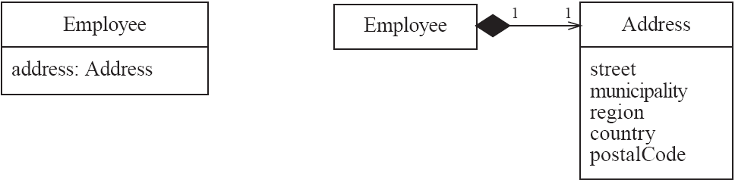
Composition
  A composition is a strong kind of aggregation
    if the aggregate is destroyed, then the parts are destroyed as well
  Two alternatives for addresses
© Lethbridge/Laganière 2012
Chapter 5: Modelling with classes

Slide 29
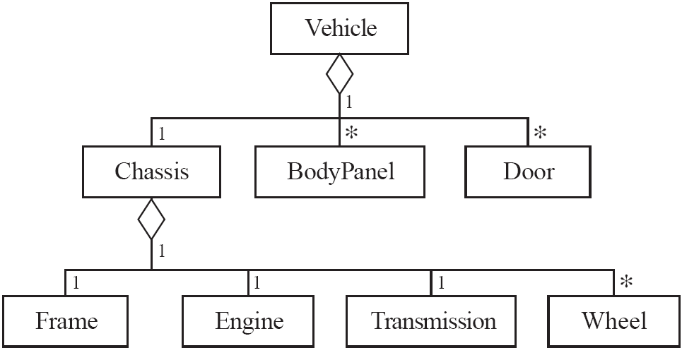
Aggregation hierarchy
© Lethbridge/Laganière 2012
Chapter 5: Modelling with classes

Slide 30

Propagation
  A mechanism where an operation in an aggregate is implemented by having the aggregate perform that operation on its parts
  At the same time, properties of the parts are often propagated back to the aggregate
  Propagation is to aggregation as inheritance is to generalization.
    The major difference is:
      inheritance is an implicit mechanism
      propagation has to be programmed when required
© Lethbridge/Laganière 2012
Chapter 5: Modelling with classes

Slide 31
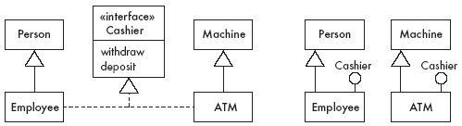
Interfaces
An interface describes a portion of the visible behaviour of a set of objects.
  An interface is similar to a class, except it lacks instance variables and implemented methods
© Lethbridge/Laganière 2012
Chapter 5: Modelling with classes

Slide 32
Notes and descriptive text
  Descriptive text and other diagrams
    Embed your diagrams in a larger document
    Text can explain aspects of the system using any notation you like
    Highlight and expand on important features, and give rationale
  Notes:
    A note is a small block of text embedded in a UML diagram
    It acts like a comment in a programming language
© Lethbridge/Laganière 2012
Chapter 5: Modelling with classes

Slide 33
5.7 Object Constraint Language (OCL)
OCL is a specification language designed to formally specify constraints in software modules
  An OCL expression simply specifies a logical fact (a constraint) about the system that must remain true
  A constraint cannot have any side-effects
    it cannot compute a non-Boolean result nor modify any data.
  OCL statements in class diagrams can specify what the values of attributes and associations must be
© Lethbridge/Laganière 2012
Chapter 5: Modelling with classes

Slide 34
OCL statements
OCL statements can be built from:
  References to role names, association names, attributes and the results of operations
  The logical values true and false
  Logical operators such as and, or, =, >, < or <> (not equals)
  String values such as: ‘a string’
  Integers and real numbers
  Arithmetic operations *, /, +, -
© Lethbridge/Laganière 2012
Chapter 5: Modelling with classes

Slide 35
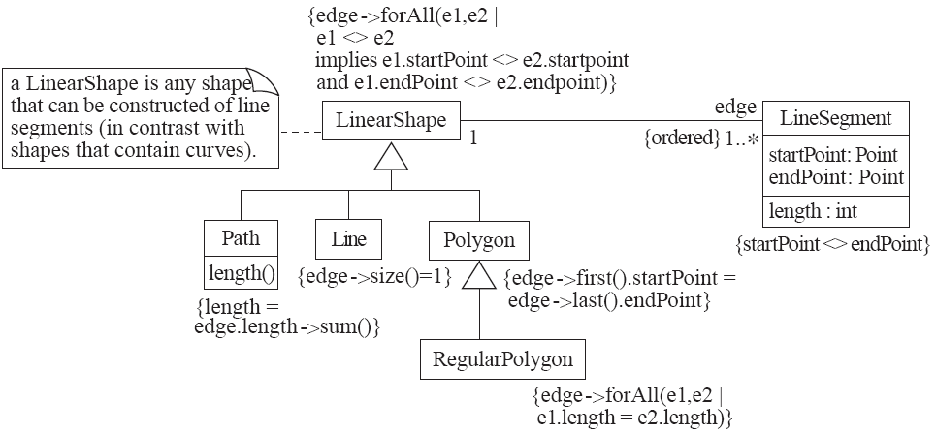
An example: constraints on Polygons
© Lethbridge/Laganière 2012
Chapter 5: Modelling with classes

Slide 36
Places to use OCL in UML models
  To specify invariants on classes and types in the class model
  To specify type invariant for stereotypes
  To describe pre- and post- conditions on operations and methods
  To describe guards
  As a navigation language
  To specify constraints on operations
SEG4110 - Topic E - Object Constraint Language

Slide 37
Collection types and navigation in OCL expressions
If self is class C, with attribute a
  Then self.a evaluates to the object stored in a.
If C has a one-to-many association called assoc to another class D
  Then self.assoc evaluates to a Set whose elements are of type D.
  If assoc is {ordered} then a Sequence results
If D has attribute b
  Then the expression self.assoc.b evaluates to the set of all the b’s belonging to D
SEG4110 - Topic E - Object Constraint Language

Slide 38
Example expressions
context Company
inv: self.manager.isUnemployed = false
-- self.manager evaluates to a Person
inv: self.employee->notEmpty()
-- self.employee evaluates to a Set
Note: ->notEmpty() is a call to an OCL built in Collection function
  Discussed a bit later
SEG4110 - Topic E - Object Constraint Language

Slide 39
Some important OCL built in Collection functions
aCollection->isEmpty(), ->notEmpty
aCollection->size()
aCollection->includes(anObject)
aCollectionOfNumbers->sum()
aCollection->exists(booleanExpression)
  Returns true if booleanExpression is true for any element of aCollection
  This is the equivalent of the ∃ symbol in mathematical logic
SEG4110 - Topic E - Object Constraint Language

Slide 40
Select and reject: Picking subcollections
context Company inv:
self.employee->select(age > 50)->notEmpty()
-- select(age > 50) picks the people over 50
context Company inv:
self.employee->select(p | p.age > 50)->notEmpty()
->reject() just picks the opposite subset
SEG4110 - Topic E - Object Constraint Language

Slide 41
forAll: Evaluating some expression on every element of a collection (∀ in logic)
collection->forAll( v : Type | bool-expr-with-v )
collection->forAll( v | boolean-expression-with-v )
collection->forAll( boolean-expression )
The following are true if everybody in the company is called Jack
inv: self.employee->forAll( forename = 'Jack' )
inv: self.employee->forAll( p | p.forename = 'Jack' )
inv: self.employee->forAll( p : Person | p.forename = 'Jack' )
SEG4110 - Topic E - Object Constraint Language

Slide 42
Some more collection functions
c1->includesAll(c2)
  True if every element of c2 is found in c1
c1->excludesAll(c2)
  True if no element of c2 is found in c1
For sets:
s1->intersection(s2)
  The set of those elements found s1 and also in s2
s1->union(s2)
  The set of those elements found in either s1 or s2
s1->excluding(x)
  The set s1 with object x omitted.
For sequences
seq->first()
SEG4110 - Topic E - Object Constraint Language

Slide 43
forAll with two variables
Considers each pair in the Cartesian product of employees
context Company inv:
self.employee->forAll( e1, e2 : Person |
e1 <> e2 implies e1.forename <> e2.forename)
This is the same as
self.employee->forAll(e1 | self.employee->forAll (e2 |
e1 <> e2 implies e1.forename <> e2.forename))
SEG4110 - Topic E - Object Constraint Language

Slide 44
An example class invariant
The following all say the same thing
  numberOfEmployees > 50
  self.numberOfEmployees > 50
  context Company inv:
  self.numberOfEmployees > 50
  context c : Company inv:
  c.numberOfEmployees > 50
  context c : Company inv enoughEmployees:
  c.numberOfEmployees > 50
SEG4110 - Topic E - Object Constraint Language

Slide 45
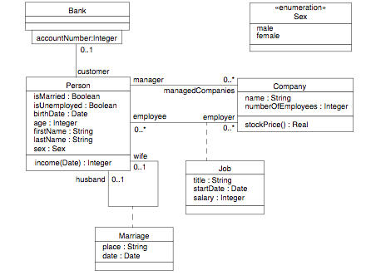
A class diagram for discussion
(from the OCL specification
SEG4110 - Topic E - Object Constraint Language

Slide 46
OCL – Context and self
All classifiers (types, classes, interfaces, associations, datatypes, . . .) from an UML model are types in the OCL expressions that are attached to the model
• Each OCL expression is written in the context of an instance of a specific type
context Person
...
• Reserved word self is used to refer to the contextual instance
• If the context is Person, self refers to an instance of Person
© Lethbridge/Laganière 2001
Chapter 5: Modelling with classes

Slide 47
Object and Properties
• The value of a property of an object defined in a class diagram is specified by a dot followed by the name of the property
• If the context is Person, self.age denotes the value of attribute age on the instance of Person identified by self
• The type of the expression is the type of attribute age, i.e., Integer
• If the context is Company, self.stockPrice() denotes the value of operation stockPrice on the instance identified by self

Slide 48
Invariants
Determine a constraint that must be true for all instances of a type
Value of attribute noEmployees in instances of Company must be less than or equal to 50
    context Company inv:
    self.noEmployees <= 50
• Equivalent formulation with a c playing the role of self, and a name for the constraint
    context c: Company inv SME:
    c.noEmployees <= 50
• The stock price of companies is greater than 0 ?

Slide 49
Pre- and Post-conditions
Constraints associated with an operation or other behavioral feature
Pre-condition: Constraint assumed to be true before the operation is executed
Post-condition: Constraint satisfied after the operation is executed
context Person::income(): Integer
pre: self.age >= 18
post: result < 5000
© Lethbridge/Laganière 2012
Chapter 5: Modelling with classes

Slide 50
Navigating Associations
• From an object, an association is navigated using the opposite role name
    context Company
    inv: self.manager.isUnemployed = false
    inv: self.employee->notEmpty()
• Value of expression depends on maximal multiplicity of the association end:
1: value is an object
*: value is a Set of objects (an OrderedSet if association is {ordered})
• If role name is missing, the name of the type at the association end starting with a lowercase character is used (provided it is not ambiguous)
© Lethbridge/Laganière 2012
Chapter 5: Modelling with classes

Slide 51
Navigating Associations (2)
When multiplicity is at most one, association can be used as a single object or as a set containing a single object
self.manager is an object of type Person
    context Company inv:
    self.manager.age > 40
self.manager as a set
context Company inv:
self.manager->size() = 1
© Lethbridge/Laganière 2012
Chapter 5: Modelling with classes

Slide 52
Types
Type | Operations
Boolean | and, or, xor, not, implies, if-then-else-endif
Integer | +, -, *, /, abs, div, mod, max, min
Real | +, -, *, /, abs, div, mod, max, min, floor, round
String | size, concat, substring, toInteger, toReal
© Lethbridge/Laganière 2001
Chapter 5: Modelling with classes

Slide 53
Operations for Collections
Opération | Usage
isEmpty | aCollection->isEmpty()
notEmpty | aCollection-> notEmpty ()
includes | aCollection->includes(anObject)
excludes | aCollection->excludes(anObject)
sum | aCollectionOfNumbers->sum()
exists | aCollection->exists(booleanExpression)
size | aCollection->size()
© Lethbridge/Laganière 2001
Chapter 5: Modelling with classes

Slide 54
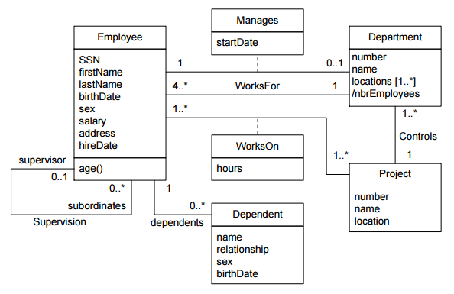
Example
© Lethbridge/Laganière 2001
Chapter 5: Modelling with classes

Slide 55
Example (2)
The supervisor of an employee must be older than the employee
The salary of an employee cannot be greater than the salary of his/her supervisor
The manager of a department must be an employee of the department
The SSN of employees is an identifier (must be unique)
The location of a project must be one of the locations of its department
A project can have at most 2 employees working on the project less than 10 hours
An employee cannot supervise him/herself
© Lethbridge/Laganière 2001
Chapter 5: Modelling with classes

Slide 56
5.9 The Process of Developing Class Diagrams
You can create UML models at different stages and with different purposes and levels of details
  Exploratory domain model:
    Developed in domain analysis to learn about the domain
  System domain model:
    Models aspects of the domain represented by the system
  System model:
    Includes also classes used to build the user interface and system architecture
© Lethbridge/Laganière 2012
Chapter 5: Modelling with classes

Slide 57
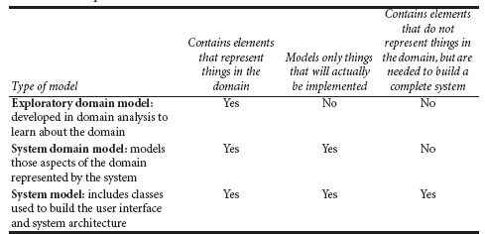
System domain model vs System model
© Lethbridge/Laganière 2012
Chapter 5: Modelling with classes

Slide 58
System domain model vs System model
  The system domain model omits many classes that are needed to build a complete system
    Can contain less than half the classes of the system.
    Should be developed to be used independently of particular sets of
      user interface classes
      architectural classes
  The complete system model includes
    The system domain model
    User interface classes
    Architectural classes
    Utility classes
© Lethbridge/Laganière 2012
Chapter 5: Modelling with classes

Slide 59
Suggested sequence of activities
  Identify a first set of candidate classes
  Focus on the core 1-2 classes initially
    Add associations and attributes
    Find generalizations
    Iterate for the other classes
  List the main responsibilities of each class
  Decide on specific operations
  Iterate until the model is satisfactory
    Add or delete classes, associations, attributes, generalizations, responsibilities or operations
    Identify interfaces
    Apply design patterns (Chapter 6)
Don’t be too disorganized. Don’t be too rigid either.
© Lethbridge/Laganière 2012
Chapter 5: Modelling with classes

Slide 60
Identifying classes
  When developing a domain model you tend to discover classes
  When you work on the user interface or the system architecture, you tend to invent classes
    Needed to solve a particular design problem
    (Inventing may also occur when creating a domain model)
  Reuse should always be a concern
    Frameworks
    System extensions
    Similar systems
© Lethbridge/Laganière 2012
Chapter 5: Modelling with classes

Slide 61
A simple technique for discovering domain classes
  Look at a source material such as a description of requirements
  Extract the nouns and noun phrases
  Eliminate nouns that:
    are redundant
    represent instances
    are vague or highly general
    not needed in the application
  Pay attention to classes in a domain model that represent types of users or other actors
© Lethbridge/Laganière 2012
Chapter 5: Modelling with classes

Slide 62
Identifying associations and attributes
  Start with classes you think are most central and important
  Decide on the clear and obvious data it must contain and its relationships to other classes.
  Work outwards towards the classes that are less important.
  Avoid adding many associations and attributes to a class
    A system is simpler if it manipulates less information
© Lethbridge/Laganière 2012
Chapter 5: Modelling with classes

Slide 63
Tips about identifying and specifying valid associations
  An association should exist if a class
      possesses
      controls
      is connected to
      is related to
      is a part of
      has as parts
      is a member of, or
      has as members
  some other class in your model
  Specify the multiplicity at both ends
  Label it clearly.
© Lethbridge/Laganière 2012
Chapter 5: Modelling with classes

Slide 64
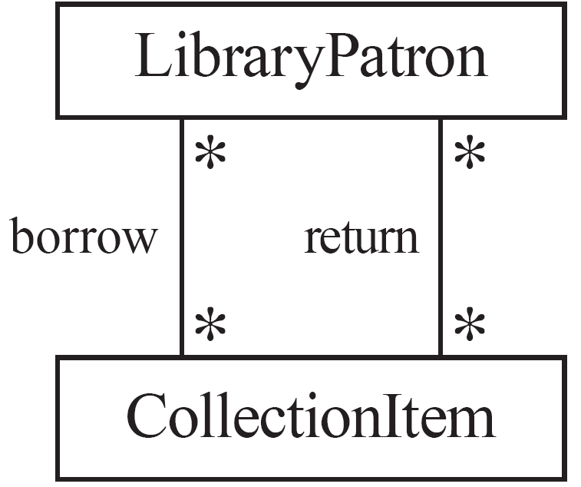
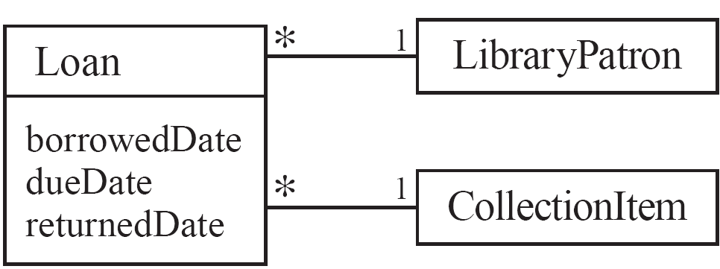
Actions versus associations
  A common mistake is to represent actions as if they were associations
Better: The
borrow
operation creates a
Loan
, and
Bad, due to the use of associations
the
return
operation sets the
returnedDate
that are actions
attribute.
© Lethbridge/Laganière 2012
Chapter 5: Modelling with classes

Slide 65
Identifying attributes
  Look for information that must be maintained about each class
  Several nouns rejected as classes, may now become attributes
  An attribute should generally contain a simple value
    E.g. string, number
© Lethbridge/Laganière 2012
Chapter 5: Modelling with classes

Slide 66
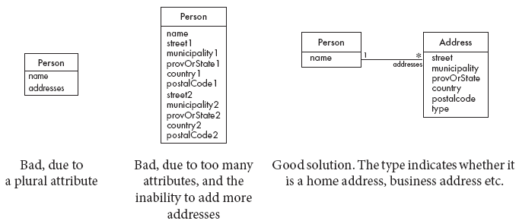
Tips about identifying and specifying valid attributes
  It is not good to have many duplicate attributes
  If a subset of a class’s attributes form a coherent group, then create a distinct class containing these attributes
© Lethbridge/Laganière 2012
Chapter 5: Modelling with classes

Slide 67
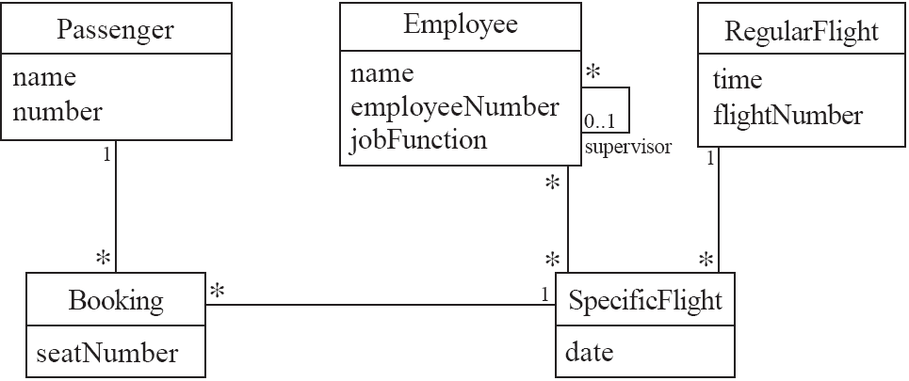
Airline example (attributes and associations)
© Lethbridge/Laganière 2012
Chapter 5: Modelling with classes

Slide 68
Top Hat Monocle Question
Attribute and association design
© Lethbridge/Laganière 2012
Chapter 5: Modelling with classes

Slide 69
Identifying generalizations and interfaces
  There are two ways to identify generalizations:
    bottom-up
      Group together similar classes creating a new superclass
    top-down
      Look for more general classes first, specialize them if needed
  Create an interface, instead of a superclass if
    The classes are very dissimilar except for having a few operations in common
    One or more of the classes already have their own superclasses
    Different implementations of the same class might be available
© Lethbridge/Laganière 2012
Chapter 5: Modelling with classes

Slide 70
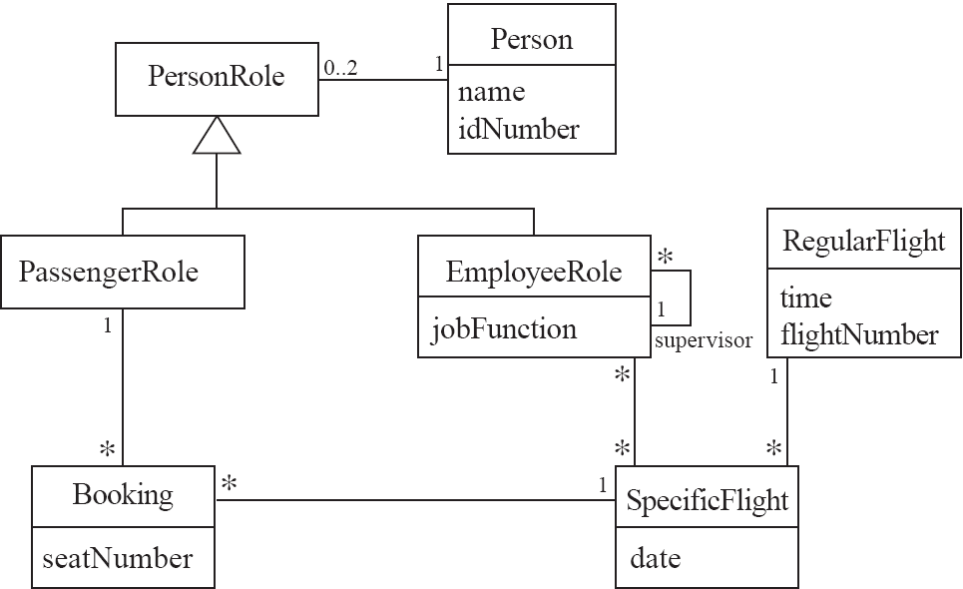
An example (generalization)
© Lethbridge/Laganière 2012
Chapter 5: Modelling with classes

Slide 71
Allocating responsibilities to classes
A responsibility is something that the system is required to do.
  Each functional requirement must be attributed to one of the classes
    All the responsibilities of a given class should be clearly related.
    If a class has too many responsibilities, consider splitting it into distinct classes
    If a class has no responsibilities attached to it, then it is probably useless
    When a responsibility cannot be attributed to any of the existing classes, then a new class should be created
  To determine responsibilities
    Perform use case analysis
    Look for verbs and nouns describing actions in the system description
© Lethbridge/Laganière 2012
Chapter 5: Modelling with classes

Slide 72
Categories of responsibilities
  Setting and getting the values of attributes
  Creating and initializing new instances
  Loading to and saving from persistent storage
  Destroying instances
  Adding and deleting links of associations
  Copying, converting, transforming, transmitting or outputting
  Computing numerical results
  Navigating and searching
  Other specialized work
© Lethbridge/Laganière 2012
Chapter 5: Modelling with classes

Slide 73
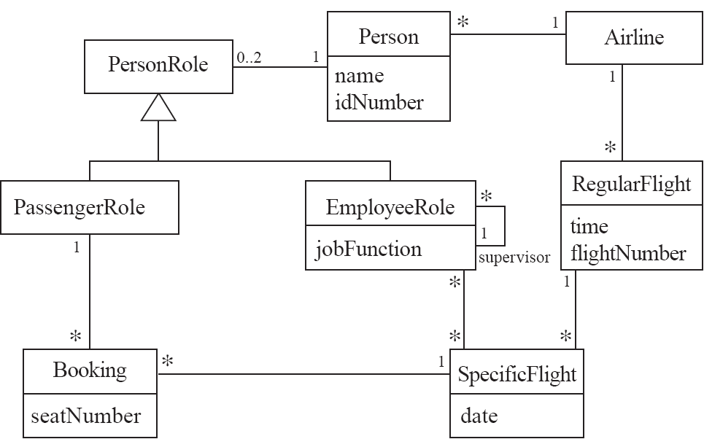
An example (responsibilities)
Creating a new regular flight
Searching for a flight
Modifying attributes of a flight
Creating a specific flight
Booking a passenger
Canceling a booking
© Lethbridge/Laganière 2012
Chapter 5: Modelling with classes

Slide 74
Prototyping a class diagram on paper
  As you identify classes, you write their names on small cards
  As you identify attributes and responsibilities, you list them on the cards
    If you cannot fit all the responsibilities on one card:
      this suggests you should split the class into two related classes.
  Move the cards around on a whiteboard to arrange them into a class diagram.
  Draw lines among the cards to represent associations and generalizations.
© Lethbridge/Laganière 2012
Chapter 5: Modelling with classes

Slide 75
Identifying operations
Operations are needed to realize the responsibilities of each class
  There may be several operations per responsibility
  The main operations that implement a responsibility are normally declared public
  Other methods that collaborate to perform the responsibility must be as private as possible
© Lethbridge/Laganière 2012
Chapter 5: Modelling with classes

Slide 76
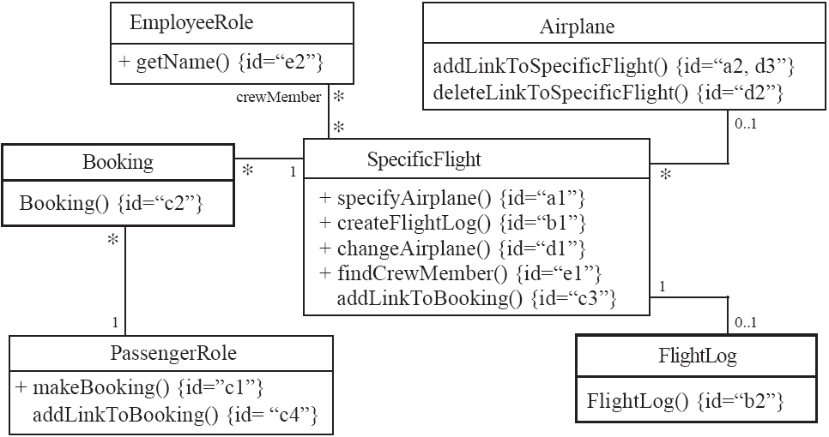
An example (class collaboration)
© Lethbridge/Laganière 2012
Chapter 5: Modelling with classes

Slide 77
Class collaboration ‘a’
SpecificFlight
*
0..1
Airplane
Making a bi-directional link between two existing objects;
e.g. adding a link between an instance of SpecificFlight and an instance of Airplane.
1. (public) The instance of SpecificFlight
    makes a one-directional link to the instance of Airplane
    then calls operation 2.
2. (non-public) The instance of Airplane
    makes a one-directional link back to the instance of SpecificFlight
© Lethbridge/Laganière 2012
Chapter 5: Modelling with classes

Slide 78
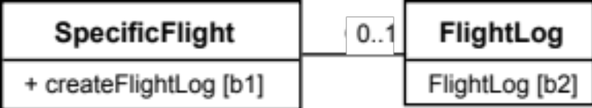
Class collaboration ‘b’
1
Creating an object and linking it to an existing object
e.g. creating a FlightLog, and linking it to a SpecificFlight.
1. (public) The instance of SpecificFlight
    calls the constructor of FlightLog (operation 2)
    then makes a one-directional link to the new instance of FlightLog.
2. (non-public) Class FlightLog’s constructor
    makes a one-directional link back to the instance of SpecificFlight.
© Lethbridge/Laganière 2012
Chapter 5: Modelling with classes

Slide 79
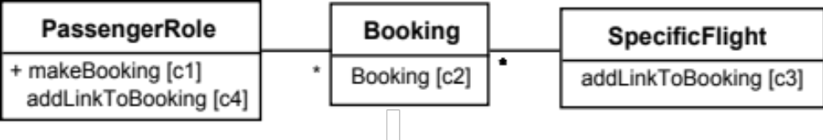
Class collaboration ‘c’
1
1
Creating an association class, given two existing objects
e.g. creating an instance of Booking, which will link a SpecificFlight to a PassengerRole.
1. (public) The instance of PassengerRole
    calls the constructor of Booking (operation 2).
2. (non-public) Class Booking’s constructor, among its other actions
    makes a one-directional link back to the instance of PassengerRole
    makes a one-directional link to the instance of SpecificFlight
    calls operations 3 and 4.
3. (non-public) The instance of SpecificFlight
    makes a one-directional link to the instance of Booking.
4. (non-public) The instance of PassengerRole
    makes a one-directional link to the instance of Booking.
© Lethbridge/Laganière 2012
Chapter 5: Modelling with classes

Slide 80
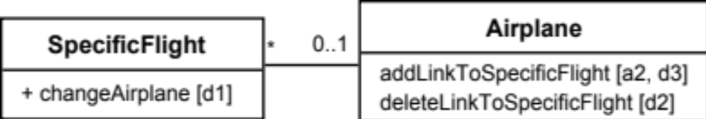
Class collaboration ‘d’
Changing the destination of a link
e.g. changing the Airplane of to a SpecificFlight, from airplane1 to airplane2
1. (public) The instance of SpecificFlight
    deletes the link to airplane1
    makes a one-directional link to airplane2
    calls operation 2
    then calls operation 3.
2. (non-public) airplane1
    deletes its one-directional link to the instance of SpecificFlight.
3. (non-public) airplane2
    makes a one-directional link to the instance of SpecificFlight.
© Lethbridge/Laganière 2012
Chapter 5: Modelling with classes

Slide 81
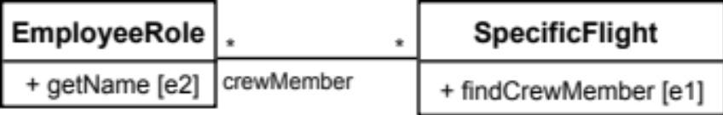
Class collaboration ‘e’
Searching for an associated instance
e.g. searching for a crew member associated with a SpecificFlight that has a certain name.
1. (public) The instance of SpecificFlight
    creates an Iterator over all the crewMember links of the SpecificFlight\
    for each of them call operation 2, until it finds a match.
2. (may be public) The instance of EmployeeRole returns its name.
© Lethbridge/Laganière 2012
Chapter 5: Modelling with classes

Slide 82
5.10 Implementing Class Diagrams in Java
  Attributes are implemented as instance variables
  Generalizations are implemented using extends
  Interfaces are implemented using implements
  Associations are normally implemented using instance variables
    Divide each two-way association into two one-way associations
      so each associated class has an instance variable.
    For a one-way association where the multiplicity at the other end is ‘one’ or ‘optional’
      declare a variable of that class (a reference)
    For a one-way association where the multiplicity at the other end is ‘many’:
      use a collection class implementing List, such as Vector
© Lethbridge/Laganière 2012
Chapter 5: Modelling with classes

Slide 83
Example: SpecificFlight
class SpecificFlight
{
private Calendar date;
private RegularFlight regularFlight;
...
// Constructor that should only be called from
// addSpecificFlight
SpecificFlight( Calendar aDate, RegularFlight aRegularFlight)
{
date = aDate;
regularFlight = aRegularFlight;
}
}
© Lethbridge/Laganière 2012
Chapter 5: Modelling with classes

Slide 84
Example: RegularFlight
class RegularFlight
{
private List specificFlights;
...
// Method that has primary responsibility
public void addSpecificFlight(Calendar aDate)
{
SpecificFlight newSpecificFlight;
newSpecificFlight = new SpecificFlight(aDate, this);
specificFlights.add(newSpecificFlight);
}
...
}
© Lethbridge/Laganière 2012
Chapter 5: Modelling with classes

Slide 85
5.11 Difficulties and Risks when creating class diagrams
  Modeling is particularly difficult skill
    Even excellent programmers have difficulty thinking at the appropriate level of abstraction
    Education traditionally focus more on design and programming than modeling
  Resolution:
    Ensure that tem members have adequate training
    Have experienced modeler as part of the team
    Review all models thoroughly
© Lethbridge/Laganière 2012
Chapter 5: Modelling with classes

